Slide 1




STOCK
MARKET
PREDICTION
~BY
ARUNANGSHU NAG
GAURAV KUMAR
DEPT.: CSE YEAR:3RD

Slide 2


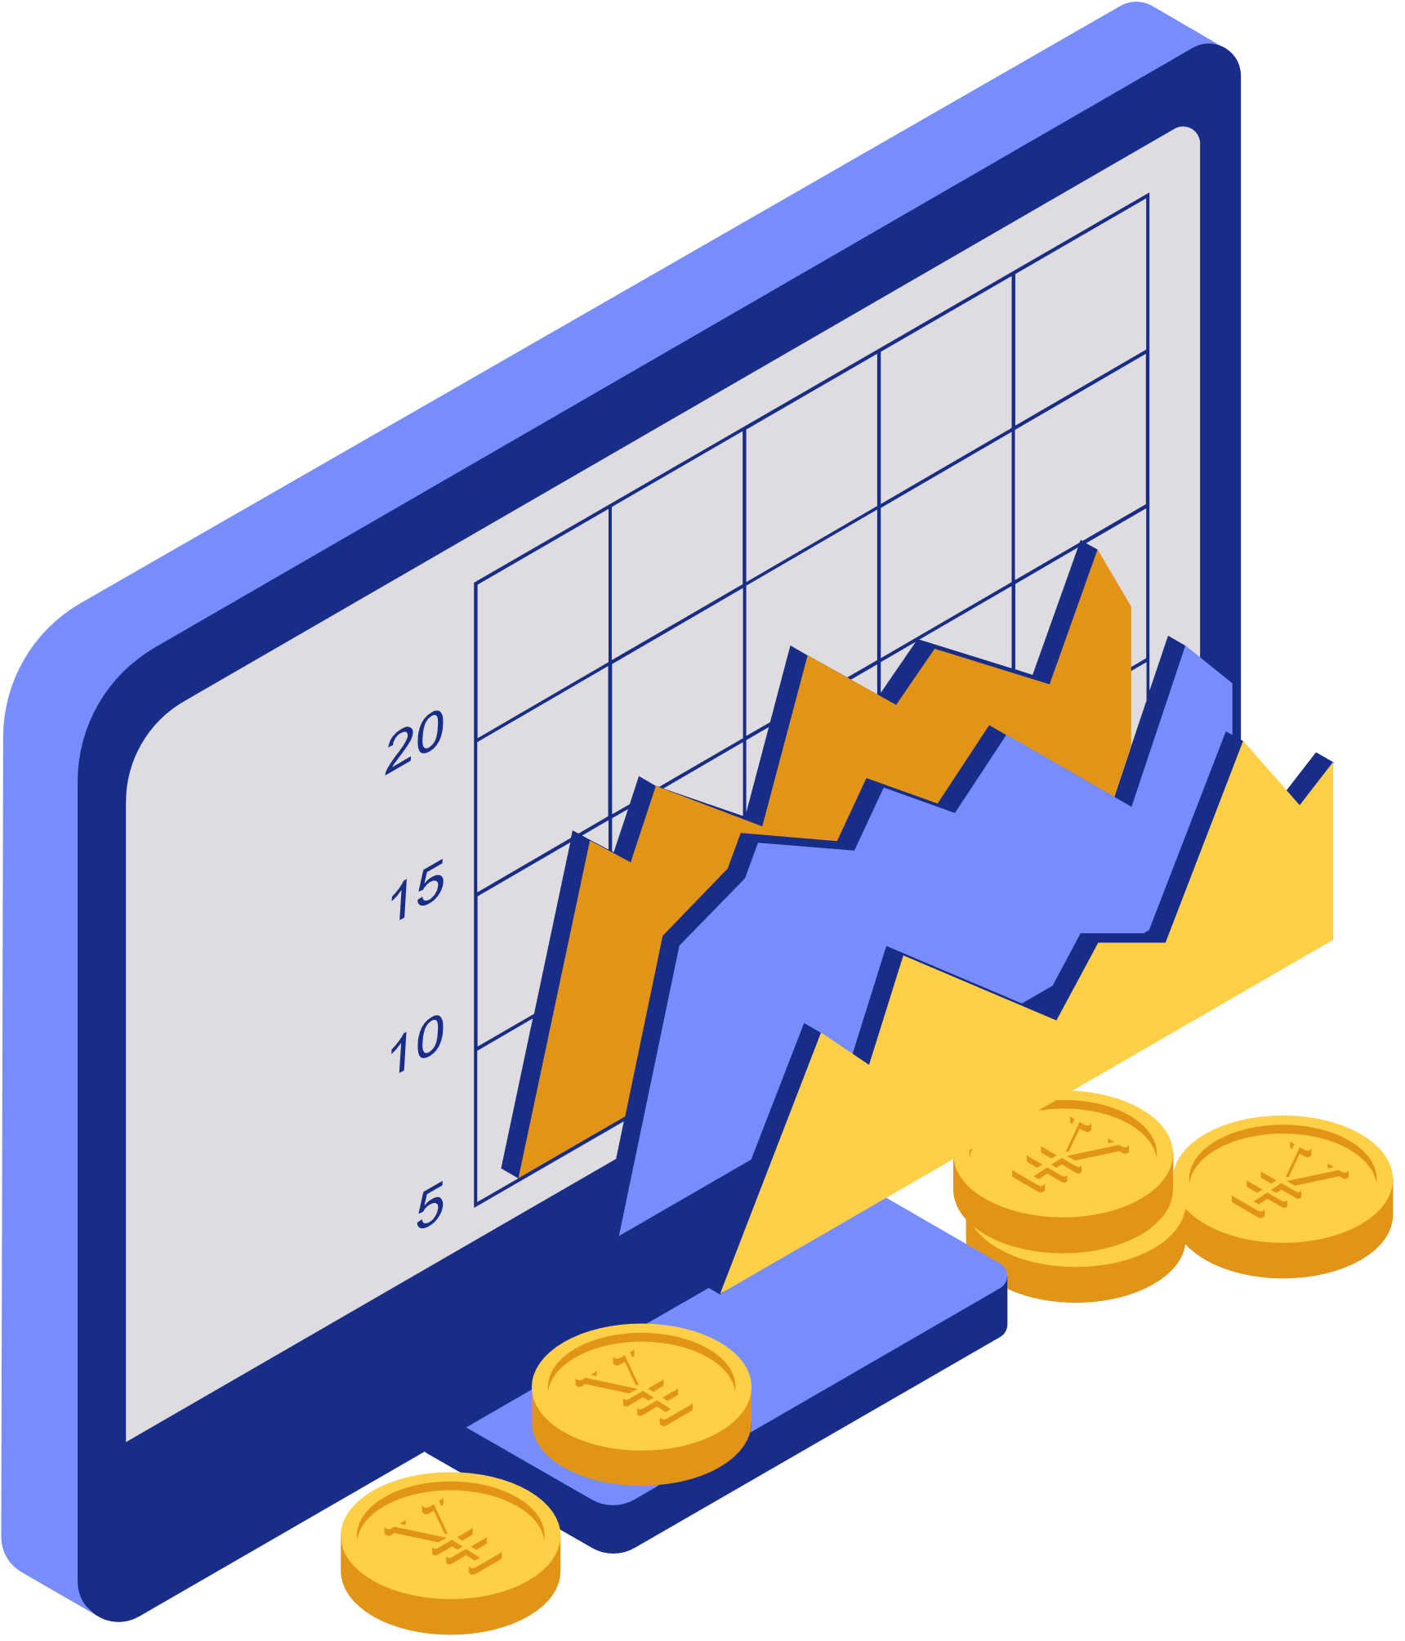

INTRODUCTION
The stock market is like a marketplace where people buy and sell ownership in companies. It's where investors can purchase shares (or "stocks") of a company, which represent a piece of ownership in that company. When companies do well, the value of their stocks tends to go up, allowing investors to make a profit. Conversely, if a company struggles, the value of its stocks may decrease, leading to potential losses for investors. Stock market prediction is the practice of using data analysis and machine learning techniques to forecast future movements in stock prices.

Slide 3





OBJECTIVES
Using Machine Learning Algorithms and statistical models to forecast future stock prices based on historical data and market trends of given stock name.
The objective is to perform time series analysis and prediction of stock prices using a Long Short-Term Memory (LSTM) neural network model.

Slide 4


LIBRARIES
TECHNOLOGIES
LANGUAGES
USED
NUMPY, PANDAS, MATPLOTLIB,
SCIKIT-LEARN, KERAS, STREAMLIT, YFINANCE
PYTHON
DATASETS
Algorithms
Long Short-Term Memory (LSTM)
YAHOO FINANCE

Slide 5


workflow
The data gathering part involves fetching historical stock price data from Yahoo Finance using the yfinance library.
Data Visualization
&
Moving Average Calculation
Visualization of Predicted Result
Data
Gathering
01.
02.
03.
04.
05.
06.
Data
Preprocessing
Model Creation
Result Web App Interface
Drop missing values, split data into training and testing sets, and scale features between 0 and 1 using MinMaxScaler.
Using LSTM-based neural network with dropout regularization, compile with Adam optimizer, and train on training data.
Using streamlit framework the predictor is displayed

Slide 6

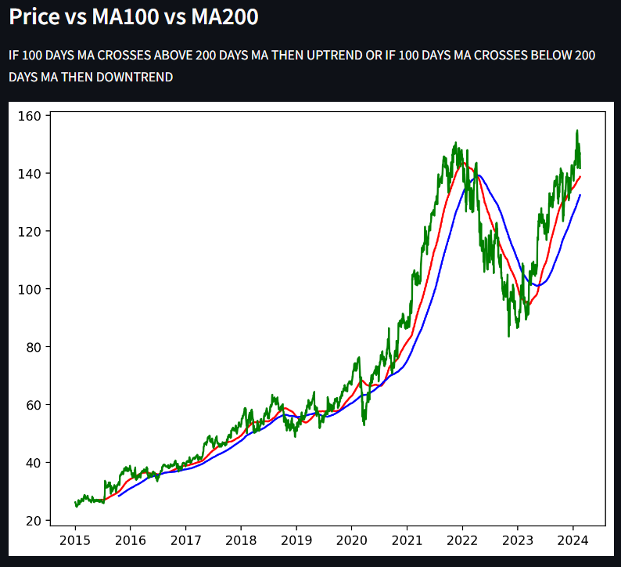
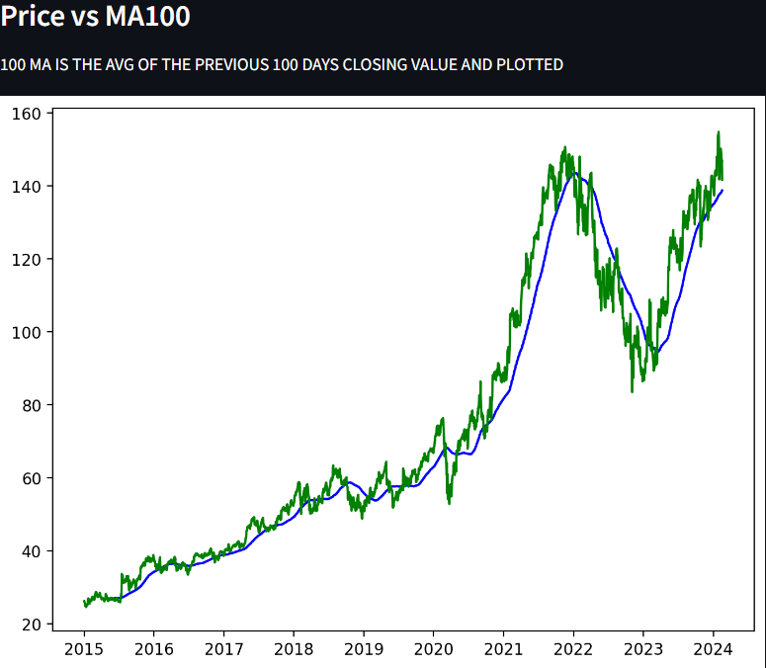


Data Visualization & Moving Average
A moving average in the context of stocks refers to a technical analysis tool used by investors and traders to smooth out price data over a specified period, typically by calculating the average price of a security over a set number of days.

Slide 7
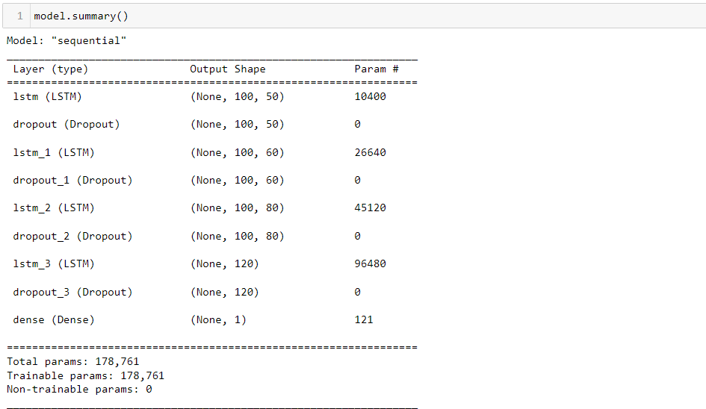
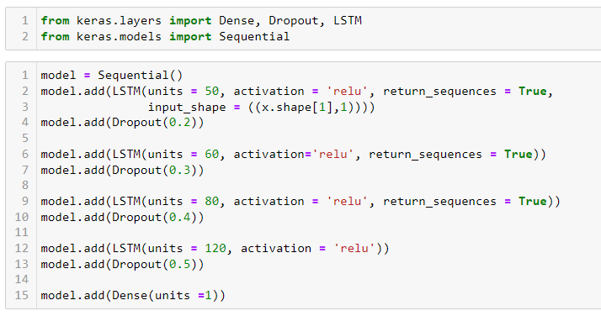

model creation
Our LSTM-based model employs dropout regularization and multi-layered architecture to forecast stock prices using historical data. Trained with Adam optimizer, it captures sequential dependencies, ensuring scalability and accurate predictions, aiding investors, traders, and analysts in decision-making processes for financial markets.

Slide 8

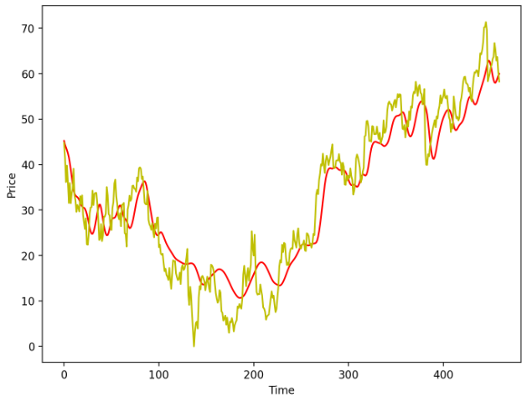
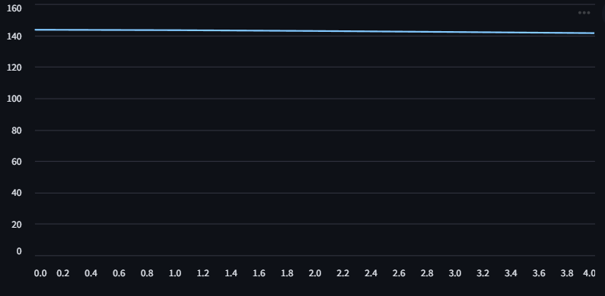

RESULT PREDICTION
Predicted Price v/s Original Price
FUTURE PRICE PREDICTION
Graph of future predicted price
of next 5 days
Graph of predicted price vs original price of last 100 days data

Slide 9


FUTURE ASPECTS
Increase accuracy & performance by using advanced model architecture.
To check insights and predict more trends of the stock for user.
Proper web app deployment.
Financial research and education.

Slide 10


CONCLUSION
In conclusion, our stock market prediction project utilized LSTM neural networks to forecast future stock prices based on historical data. While the model demonstrated promising results in capturing temporal dependencies, accurately predicting stock prices remains challenging due to market unpredictability and noise. Future improvements may involve fine-tuning model architecture and incorporating additional features like market indicators or sentiment analysis. Despite limitations, this project underscores the potential of machine learning in financial forecasting, offering valuable insights for investment strategies and risk management. Continued exploration and refinement of techniques are essential for advancing predictive accuracy in the dynamic landscape of stock markets.

Slide 11


THANK YOU!

